Slide 1

Features and Loss Functions in Speech Enhancement
$$\text{Szu}\text{−}\text{Wei} \text{Fu}$$ 2020/07/08

Slide 2
Different input features (magnitude spectrogram, and raw waveform[2, 3])
[2] S.-W. Fu, Y. Tsao, X. Lu, and H. Kawai, "Raw waveform-based speech enhancement by fully convolutional networks," in APSIPA, 2017. (more than 50 citations)
[3] S.-W. Fu, Y. Tsao, X. Lu, and H. Kawai, "End-to-End Waveform Utterance Enhancement for Direct Evaluation Metrics Optimization by Fully Convolutional Neural Networks," IEEE Transactions on Audio, Speech, and Language Processing (TASLP), 2018. (top 10 most popular article in recent months of TASLP, more than 50 citations)

Slide 3
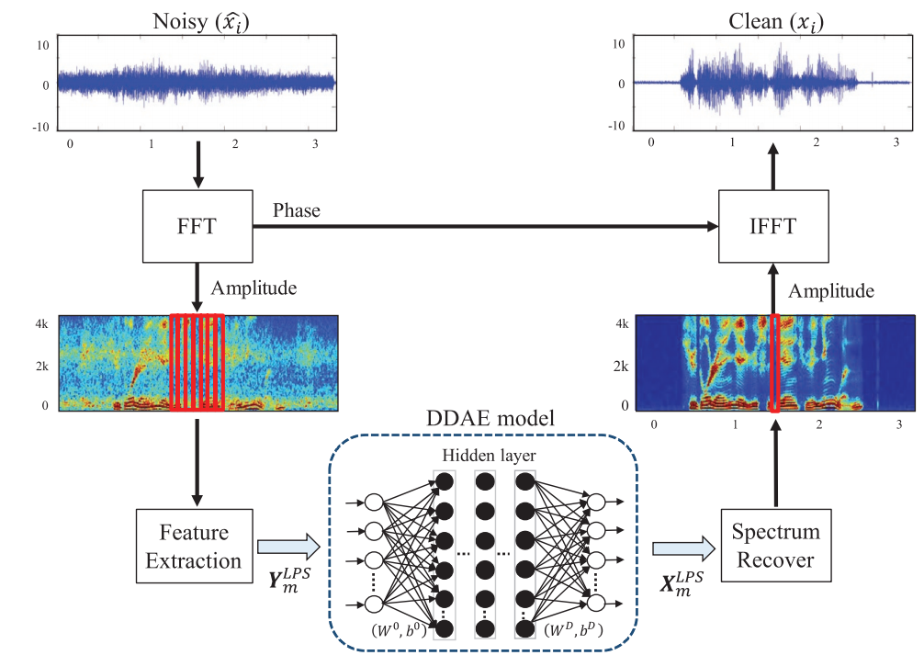
Motivation
Usually ignored…
magnitude spectrogram

Slide 4
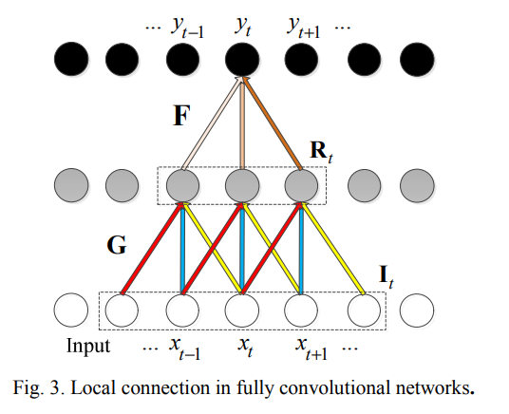
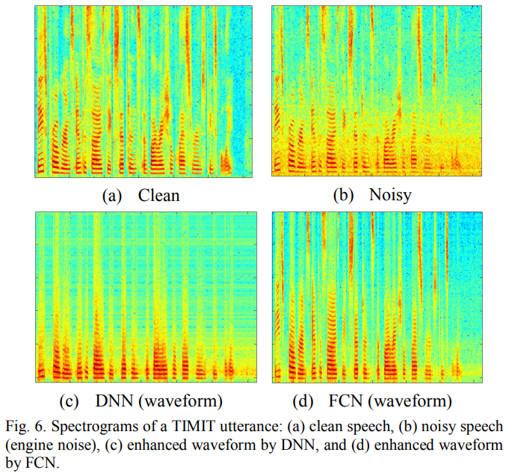
Different input features
Raw waveform (frame based) [2]:
[2] S.-W. Fu, Y. Tsao, X. Lu, and H. Kawai, "Raw waveform-based speech enhancement by fully convolutional networks," in APSIPA, 2017.

Slide 5
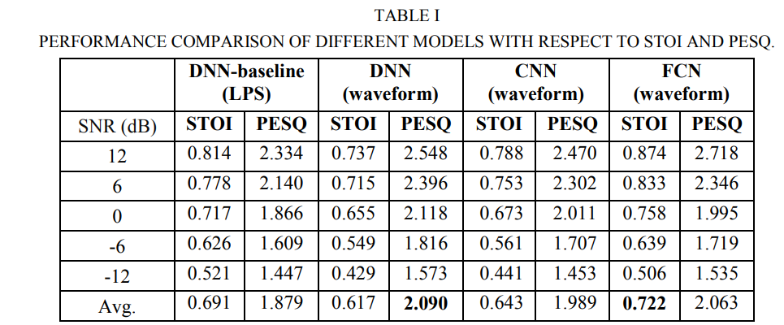
Different input features
Raw waveform (frame based) [2]:
[2] S.-W. Fu, Y. Tsao, X. Lu, and H. Kawai, "Raw waveform-based speech enhancement by fully convolutional networks," in APSIPA, 2017.

Slide 6
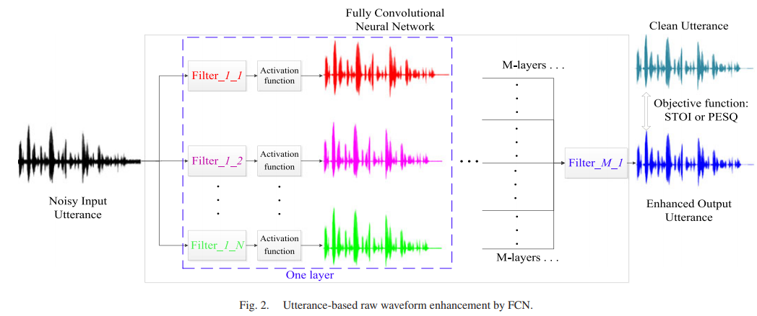
Different input features
Raw waveform (utterance based) [3]:
[3] S.-W. Fu, Y. Tsao, X. Lu, and H. Kawai, "End-to-End Waveform Utterance Enhancement for Direct Evaluation Metrics Optimization by Fully Convolutional Neural Networks," IEEE Transactions on Audio, Speech, and Language Processing (TASLP), 2018. (top 10 most popular article in recent months of TASLP)

Slide 7
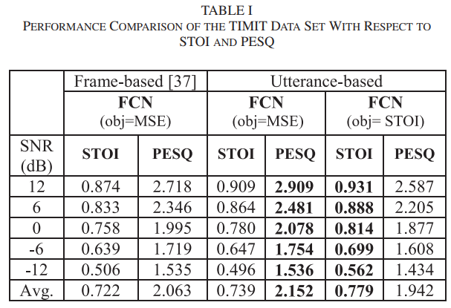
Different input features
Raw waveform (utterance based) [3]:
[3] S.-W. Fu, Y. Tsao, X. Lu, and H. Kawai, "End-to-End Waveform Utterance Enhancement for Direct Evaluation Metrics Optimization by Fully Convolutional Neural Networks," IEEE Transactions on Audio, Speech, and Language Processing (TASLP), 2018. (top 10 most popular article in recent months of TASLP)

Slide 8
Different loss function (MSE, STOI [3,5], and PESQ[4,5])
[3] S.-W. Fu, Y. Tsao, X. Lu, and H. Kawai, "End-to-End Waveform Utterance Enhancement for Direct Evaluation Metrics Optimization by Fully Convolutional Neural Networks," IEEE Transactions on Audio, Speech, and Language Processing (TASLP), 2018. (top 10 most popular article in recent months of TASLP)
[4] S.-W. Fu, C.-F. Liao, and Y. Tsao and S.-D. Lin, " Learning with Learned Loss Function: Speech Enhancement with Quality-Net to Improve Perceptual Evaluation of Speech Quality," in arXiv, 2019.
[5] S.-W. Fu, C.-F. Liao, Y. Tsao and S.-D. Lin, " MetricGAN: Generative Adversarial Networks based Black-box Metric Scores Optimization for Speech Enhancement," in ICML, 2019. (Long oral with Travel Awards)

Slide 9
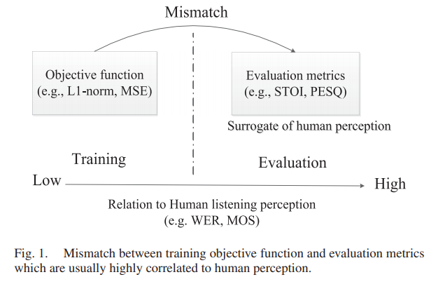
Motivation
Mean squared error (MSE) loss doesn’t consider human perception.

Slide 10
Evaluation
PESQ was designed to evaluate the quality of processed speech, and the score ranges from -0.5 to 4.5.
STOI was designed to compute the speech intelligibility, and the score ranges from 0 to 1.
PESQ function are complex and not fully differentiable.
=> It is difficult to directly optimize theses scores.

Slide 11

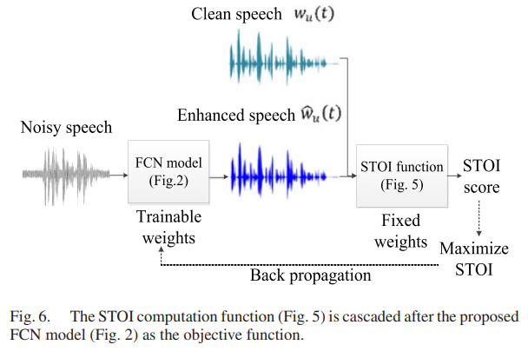
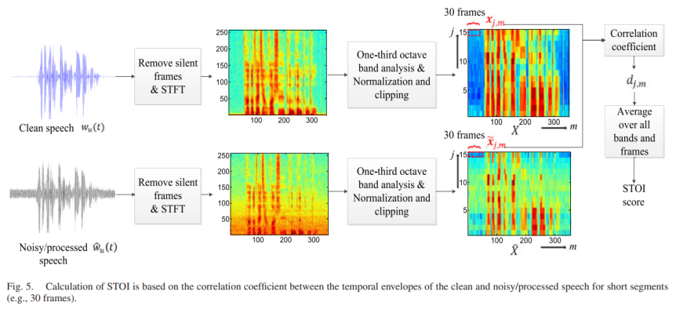
Different loss function
STOI optimization [3]:
[3] S.-W. Fu, Y. Tsao, X. Lu, and H. Kawai, "End-to-End Waveform Utterance Enhancement for Direct Evaluation Metrics Optimization by Fully Convolutional Neural Networks," IEEE Transactions on Audio, Speech, and Language Processing (TASLP), 2018. (top 10 most popular article in recent months of TASLP)

Slide 12
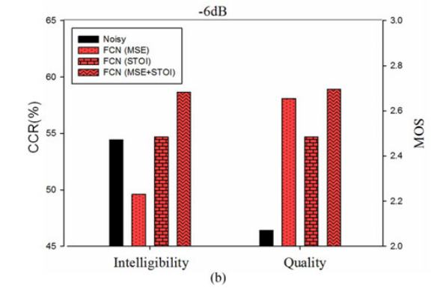
Different loss function
STOI optimization [3]:
[3] S.-W. Fu, Y. Tsao, X. Lu, and H. Kawai, "End-to-End Waveform Utterance Enhancement for Direct Evaluation Metrics Optimization by Fully Convolutional Neural Networks," IEEE Transactions on Audio, Speech, and Language Processing (TASLP), 2018. (top 10 most popular article in recent months of TASLP)

Slide 13
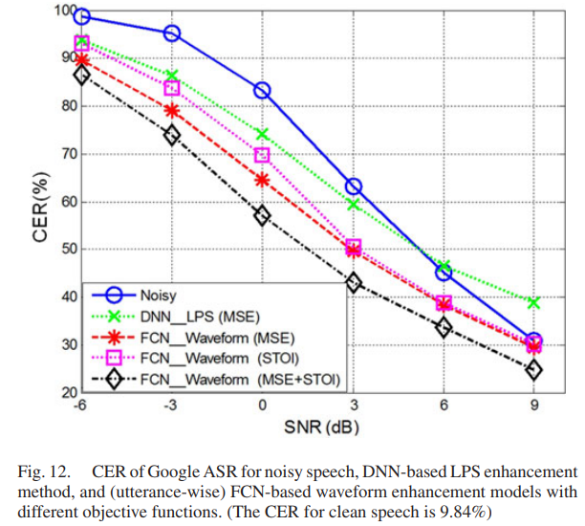
Different loss function
STOI optimization [3]:
[3] S.-W. Fu, Y. Tsao, X. Lu, and H. Kawai, "End-to-End Waveform Utterance Enhancement for Direct Evaluation Metrics Optimization by Fully Convolutional Neural Networks," IEEE Transactions on Audio, Speech, and Language Processing (TASLP), 2018. (top 10 most popular article in recent months of TASLP)

Slide 14
Different loss function
PESQ and STOI black-box optimization [5]:
MetricGAN: Generative Adversarial Networks based Black-box Metric Scores Optimization for Speech Enhancement
ICML | 2019

Slide 15
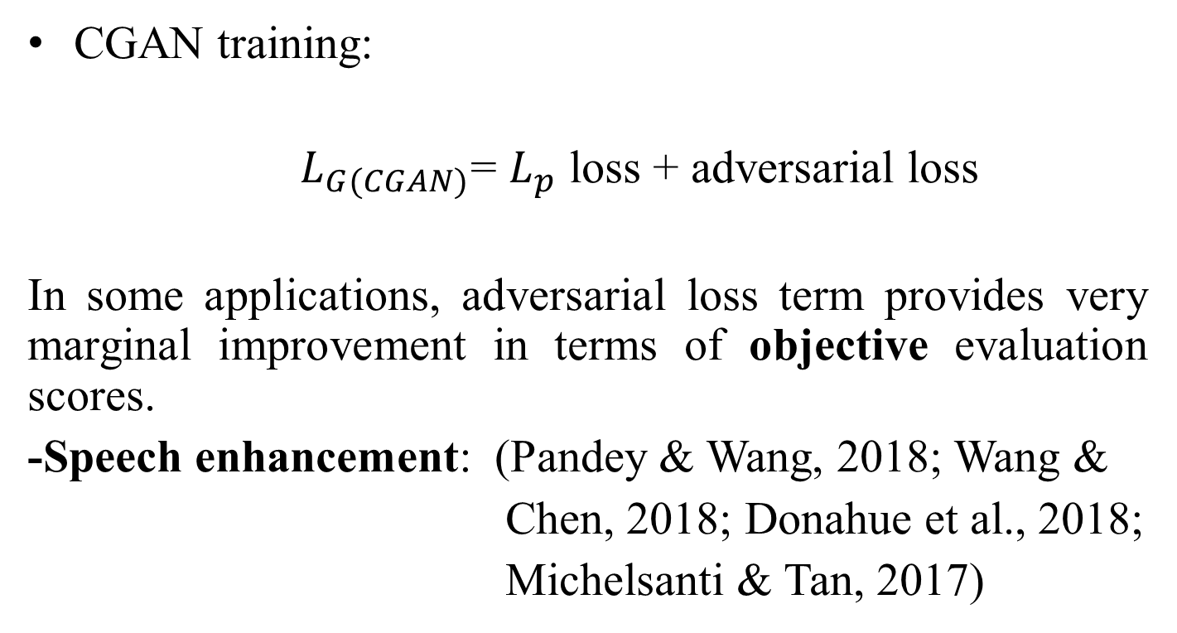
Motivation
CGAN training:
$L_{G(CGAN)}$= $L_{p}$ loss + adversarial loss
In some applications, adversarial loss term provides very marginal improvement in terms of objective evaluation scores.
-Speech enhancement: (Pandey & Wang, 2018; Wang &
Chen, 2018; Donahue et al., 2018;
Michelsanti & Tan, 2017)
Cheat discriminator (D)
-PESQ, STOI scores…
Notes:
(in the case of image processing, the subjective score can be improved).

Slide 16
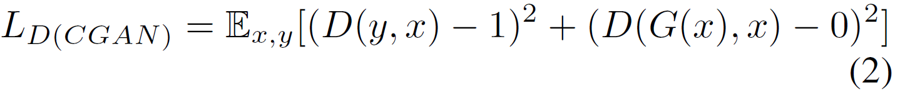
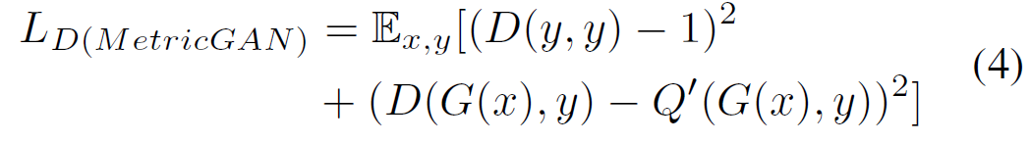

Training of D
CGAN (LSGAN):
where x and y are noisy and clean speech, respectively.
Proposed MetricGAN:
is the normalized evaluation metric (1 represents the highest evaluation score).

Slide 17
Training of G
CGAN:
where x and y are noisy and clean speech, respectively.
a large number (e.g.,1): speech enhancement model
Proposed MetricGAN:
s
a small number : speech degradation model
where s is the desired assigned score.

Slide 18
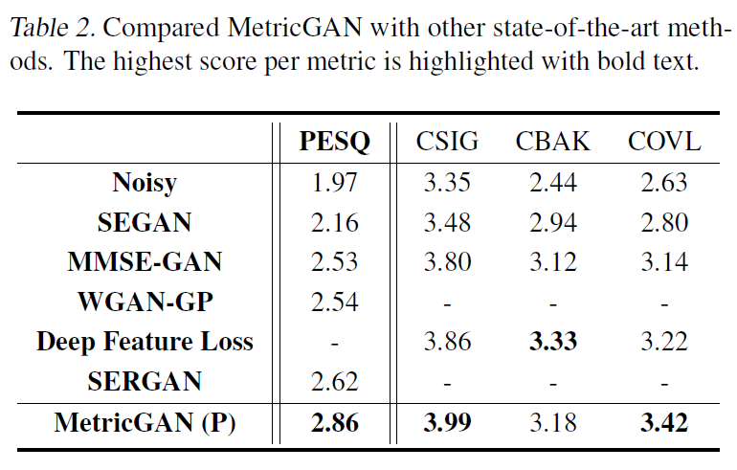
Comparison with Other SE Models
Voice Bank corpus (Valentini-Botinhao et al., 2016).

